Slide 1


KEYLOGGER
PRESENTED BY:
STUDENT NAME: SATHISH KUMAR M
REGISTER NUMBER: 110121104085
COLLEGE NAME: Aalim Muhammed Salegh College of Engineering
DEPARTMENT: Computer Science and Engineering
this presentation explores the intricacies of keyloggers - powerful software tools that record every keystroke on a computer.

Slide 2
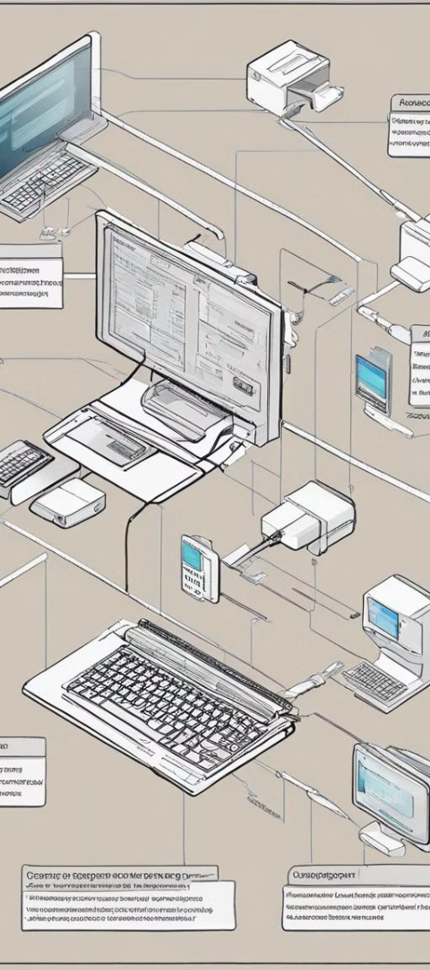
What is a Keylogger?
1
Stealth Monitoring
2
Data Theft
Keyloggers operate discreetly, capturing all user input without the victim's knowledge.
Keyloggers can collect sensitive information like passwords, credit card numbers, and personal messages.
3
Remote Access
Keyloggers can provide hackers with remote control of the compromised system.

Slide 3
Types of Keyloggers
Hardware Keyloggers
Software Keyloggers
Mobile Keyloggers
Physical devices that are secretly installed between the keyboard and computer to capture keystrokes.
Malware that runs in the background to record user activity on the infected system.
Keyloggers designed for smartphones and tablets, often disguised as legitimate apps.

Slide 4
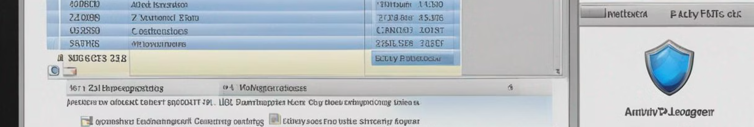
Proposed Solution
Detection
1
Use advanced antivirus and anti-malware tools to identify and remove keylogger threats.
2
Prevention
Educate users on safe browsing practices and regularly update security software.
Monitoring
3
Implement robust network monitoring and logging to quickly detect and respond to suspicious activity.

Slide 5
Risks and Dangers of Keyloggers
Identity Theft
Unauthorized Access
Keyloggers can steal sensitive personal and financial information, leading to fraud and financial losses.
Hackers can use keyloggers to gain remote control of the compromised system and carry out further attacks.
Privacy Violations
Reputational Damage
Keyloggers can compromise the privacy of individuals, exposing their confidential communications and activities.
Successful keylogger attacks can severely damage an organization's reputation and erode trust with customers and stakeholders.

Slide 6




Challenges in Addressing Cybersecurity Threats
Evolving Threats
Keyloggers and other cyber threats are constantly evolving, making it challenging to stay ahead of the curve.
Limited Resources
Organizations often lack the necessary funding, expertise, and technology to effectively combat advanced cyber threats.
User Awareness
Educating users on safe computing practices and the risks of keyloggers remains an ongoing challenge.

Slide 7




System Development Approach
User-Centric
Robust Security
Automated Monitoring
Continuous Improvement
Develop solutions that prioritize user experience and ease of use.
Implement multilayered security measures to protect against keyloggers and other threats.
Integrate real-time monitoring and incident response capabilities to quickly detect and mitigate attacks.
Regularly update and enhance the security solution to keep pace with evolving threats.

Slide 8

Keylogger output

Slide 9

Conclusion
Keyloggers pose a significant threat to individual privacy and organizational security. By implementing robust detection, prevention, and monitoring strategies, we can effectively mitigate the risks associated with these powerful surveillance tools.

Slide 10
THANK YOU !

